Slide 1
Noises Around You
Advanced Data Science Project 2 Group 8
Professor: Tian Zheng
Team member: Shuli Song, Chi Zhang, Zheyuan Chen, Yinxiang Gao, Wanyi Zhang,

Slide 2
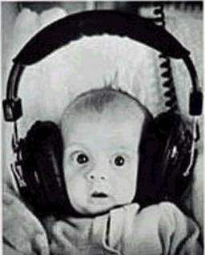
Background
I believe many people here used to meet a serious question, where should I find a good place to live? Normally most of you would like to spend a lot time in finding a home where it has a short distance from school, convenient transportation, safe environment, etc. You can find helpful information from agency, friends and google. I guess some of you found your home is perfect but it is near a hospital or you have neighbors who love to hold parties late at night, it means that you have to suffer scared noise every night. However, you have already singed the contract for one year.

Slide 3

Objective
Our goal is to provide people who want to rent a room in NYC the noise information since it is not easy to find specific noise information for your home. And people also have different noise tolerances, so if you cannot make decision to rent a room or not, come to use our app!

Slide 4
Summary
Our app can tell people whether your home is near with club&bar construction, hospital and fire station. It also displays the number and type of recent 311 complains about noise near this home, which can help people know the noise information for this place comprehensively. And we also provide the noise situation of one day, we think this is helpful for those people who just live in their rooms at night or the whole day to make decision.
Again, if you want to know noise around you, use our app!

Slide 5

Q & A

